Slide 1
Fake News Detection
Submitted by:
Niraj Patel

Slide 2
Outline
What is Fake news
Objective
Dataset
Textual Data Preprocessing
Vectorizer
Modelling
Future Scope

Slide 3
What is Fake news?
Fake news's simple meaning is to incorporate information that leads people to the wrong path.
Nowadays fake news spreading like water and people share this information without verifying it.
This is often done to further or impose certain ideas and is often achieved with political agendas.
For media outlets, the ability to attract viewers to their websites is necessary to generate online advertising revenue. So it is necessary to detect fake news.

Slide 4
Objective
To build a modal that classifies whether the data is fake or real

Slide 5
DataSet
A full training dataset with the following attributes:
id: unique id for a news article
title: the title of a news article
author: author of the news article
text: the text of the article; could be incomplete
label: a label that marks the article as potentially unreliable
1: unreliable
0: reliable

Slide 6
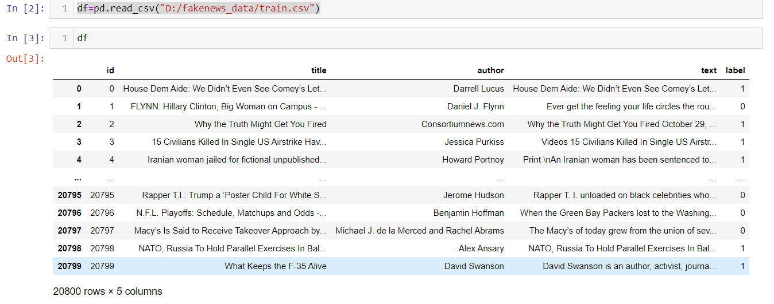

Slide 7
Textual Data Preprocessing
Data Cleaning/Preprocessing
Tokenize the word
Remove Stop Words
Remove Mentions starting with ‘@’
Convert Text into Lower Case
Splitting

Slide 8
Stemming
Stemming is the process of producing morphological variants of a base word
It takes Tokenized words as inputs and output its word stem
Examples:
Words like “History", "Historical” to the root word “Histori”
Words like “Going”, ”Goes”, ”Gone” to the root word “go”

Slide 9
Vectorizer
Count Vectorizer
It gives all the words same weight
Doesn’t have much semantic meaning
Tfidf Vectorizer
It gives weightage to more frequent words
Has Some Semantic Meaning

Slide 10
Modelling
We used Multinomial Naive Bayes because it is one of the most popular supervised learning classifications that is used for the analysis of the categorical text data. Text data classification is gaining popularity because there is an enormous amount of information available in email, documents, websites, etc. that needs to be analyzed.

Slide 11
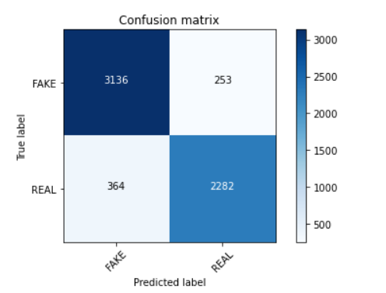
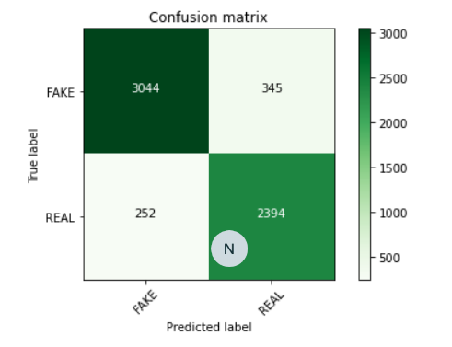
Model Evaluation
Multinomial NB Algorithm | Accuracy %(CV) | Accuracy %(Tf-idf)
Text column | 89.776 | 89.959
Title column | 90.108 | 88.020
MODEL
Score (in %)
Using Text column
Using Title column

Slide 12
Future Scope
We can implement this as a integrated feature on social media platform

